Slide 1

Showcase presentation template
Please do not edit this file. Please make a copy of this file to customize for your own presentation
Guidance for Team Leads.
Final deck is due 1 business days prior to event.
3 minutes have been allotted for your presentation this includes your 1-min demo.
Please note, there will not be any Q&A.
Pre-Event
Utilize colors and existing slide layouts, no modifications please.
to ensure a successful Showcase, please practice your presentation so you will end on time.
The showcase final deck will be shared with presenters the day before the event.
Event
Plan to join 15 minutes prior to event start time.
You will be responsible for running the deck and advance all slides.
Reminders
You must utilize Azure in your solution
Notes:
Korrie
updated 7/21

Slide 2

Student Ambassador Projects
Ambassador Projects Deck
Github Repo : HebbyHebz/MSLA_Rhino (github.com)
Notes:
Korrie

Slide 3
Team Rhino 🦏 Solution Type: Prototype
Names of Team Members : Charles Ndiaye
Ana SAA Hebron Afia
Notes:
Korrie

Slide 4

The Opportunity
Each quarter, projects are launched within the MLSA program, and each time the same participation procedures are repeated by the ambassadors and coordinators :
As an ambassador wanting to create a team and recruit members : we have to write a message for each cycle and manually scroll through hundreds of messages to find members who match our criteria.
As an ambassador wanting to join a team : we have to browse and read more than hundreds of messages in a channel to find teams and projects in our area of interest.
Notes:
Korrie
updated 7/21

Slide 5






Solution
With this in mind, the Rhino team suggests the creation of a solution using the Power Platform and AI functionality to help each ambassador accomplish his or her team projects, and which will enable coordinators to do a better follow-up.
Find a project team to join
Ambassador
Application
Recommended by AI
Find your group members or join your dream team
Notes:
Korrie
updated 7/21

Slide 6
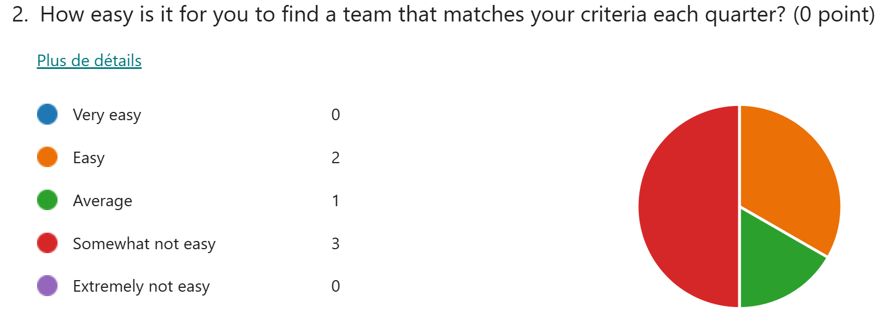
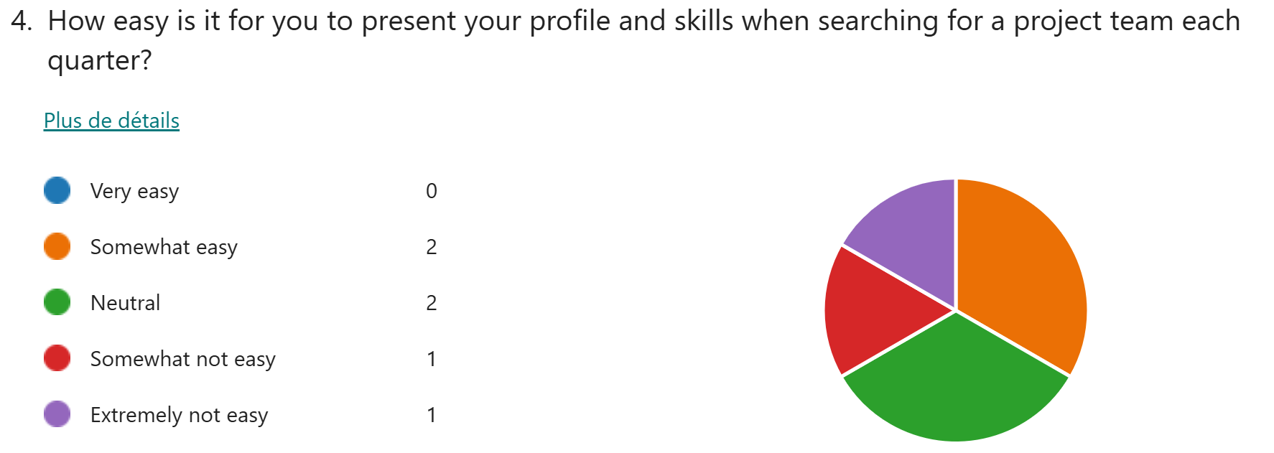
Solution
To better address our customer pain points and opportunities, we have also decided to launch a survey to get the feedbacks of ambassadors regarding the AI projects they do quarterly here are some results regarding our questions:
Feedback as an ambassador who have to search for a team and present himself to get contacted by team lead
Notes:
Korrie
updated 7/21

Slide 7
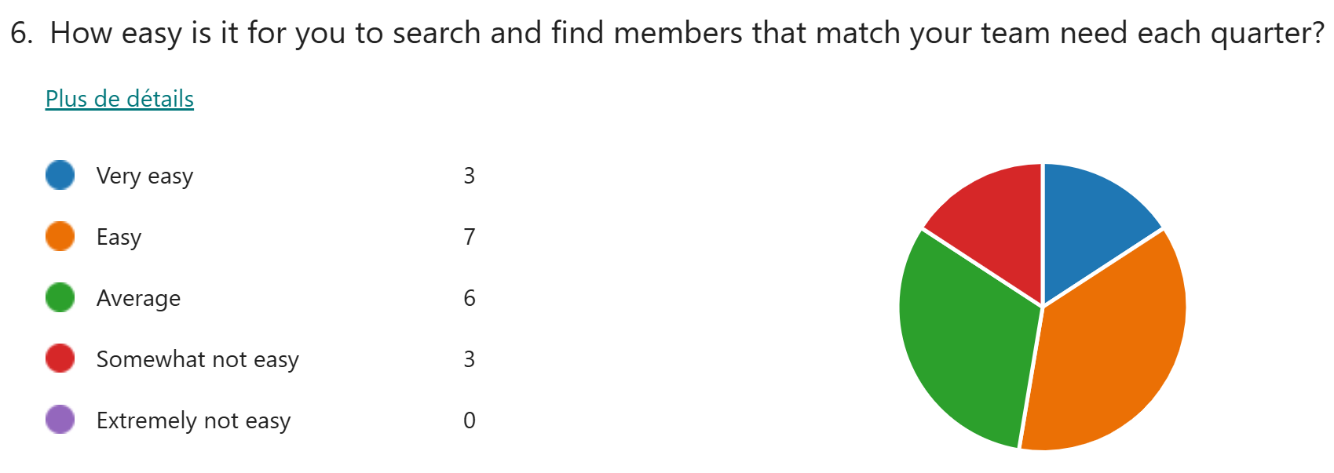
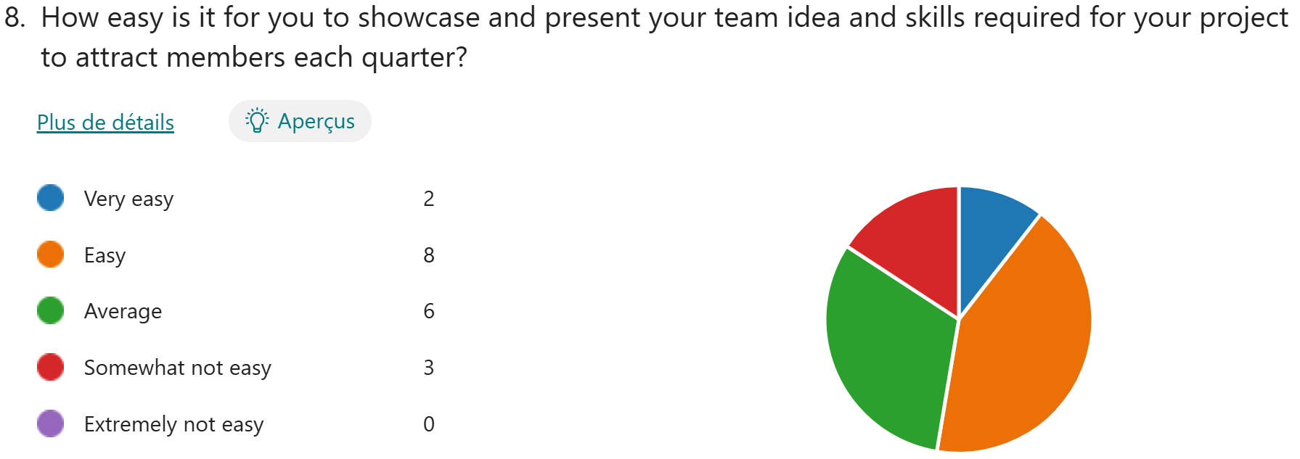
Solution
Feedback as an ambassador who have to search for team members and present his / her project to attract members to work with him/her
Notes:
Korrie
updated 7/21

Slide 8
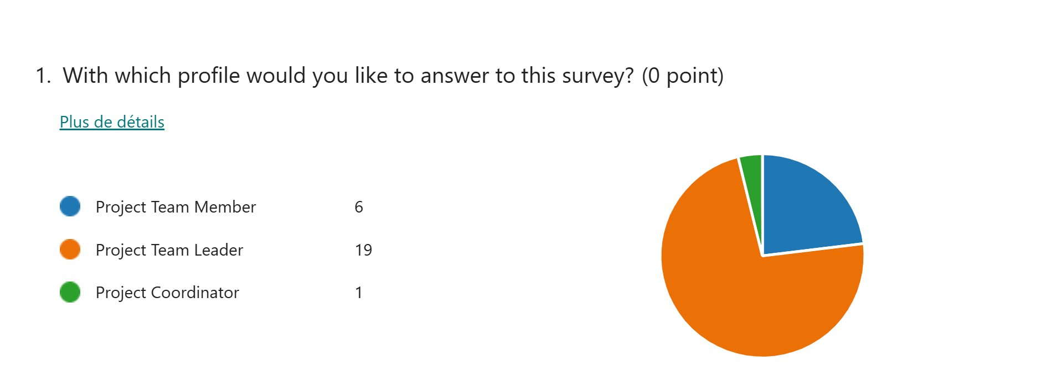
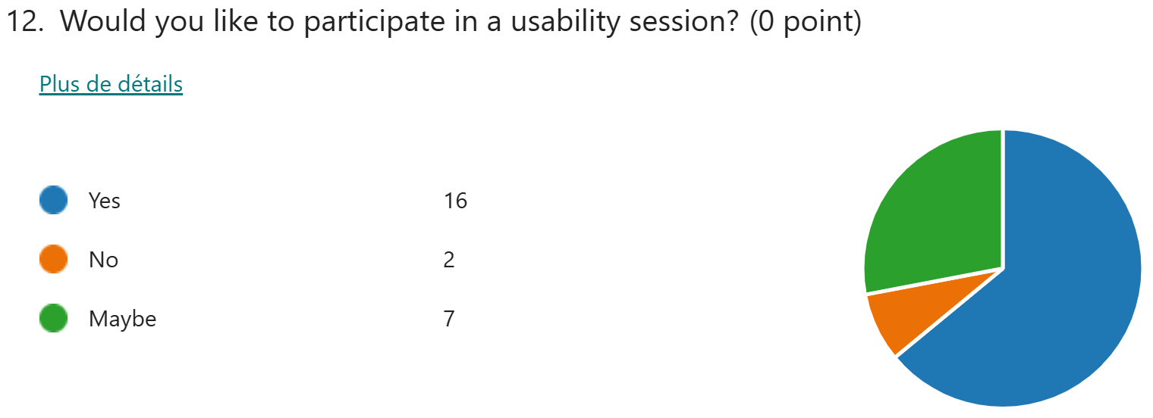
Solution
And here is the repartition of profiles which take the survey and the one that will be interested to test our solution once developed :
Notes:
Korrie
updated 7/21

Slide 9



Tools we will use
Figma
Power Platform
Azure Intelligent recommendation
Notes:
Korrie
updated 7/21

Slide 10
Demo
Important: limit demo length to 1-minute
Pre-recorded demo of solution (Video or animated gif).
Recommend no audio, but talk over the video.
Embed if <10MB, or post link here for us to download.
On occasion, a sequence of screenshots might be preferred.
Notes:
Korrie
updated 7/21

Slide 11
Takeaways
Once completed, this project will facilitate the participation of all stakeholders in an AI project. You'll no longer have to submit a message every quarter, and AI will suggest groups that match your criteria.
Notes:
Korrie
updated 7/21

